Slide 1
Dulles airport
Donovan Anderson & Nakisha Quander
Dr. Sharma
COSC 490

Slide 2
Goals & Objectives
Add functionality to the airport
Simulate a normal airport environment
Plane Take offs, etc…
Adding to the Dulles Airport model

Slide 3
Major Tools
Modeling
VRML Pad
3ds Max
More people
Vehicles
Airplanes
Skies

Slide 4
Planned Geometry
Textures
Vehicles
Aircrafts
People
Cement
Asphalt

Slide 5
The Environment
Consists of:
the airport terminals
the parking lot
main building (where bags are checked and tickets are purchased.)
Control tower
The building interior consists of:
employees behind each counter
furniture for patrons to be seated

Slide 6
Problems
Viewing and processing the project file.
Working around the modeling and animation that had already been done and making it feasible for what we were trying to do.
Time

Slide 7
Why is virtual reality the appropriate technology?
Virtual reality is important for this project because it simulates the evacuation of an airport, which can be used as a safety precaution by the airport. Also, it will save money on a real time simulation in an airport, because it would be infeasible to run the simulation during business hours.

Slide 8
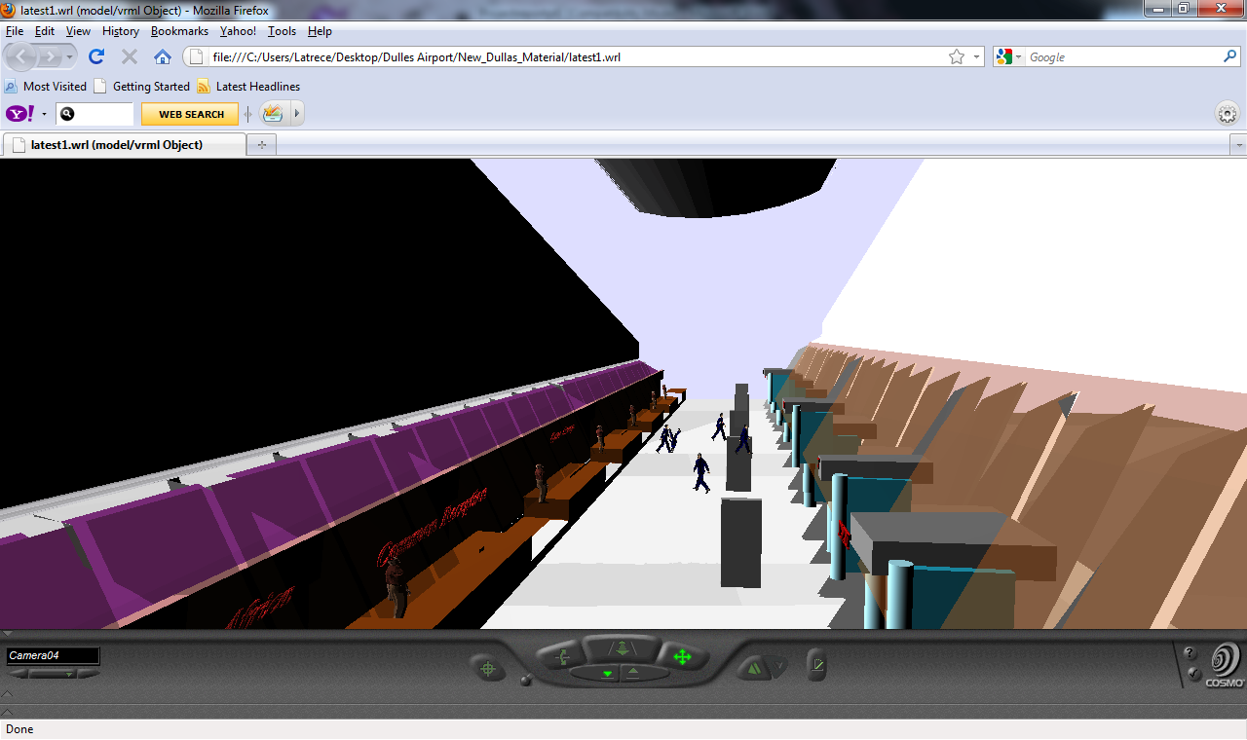
Dulles Airport
Airport Interior

Slide 9
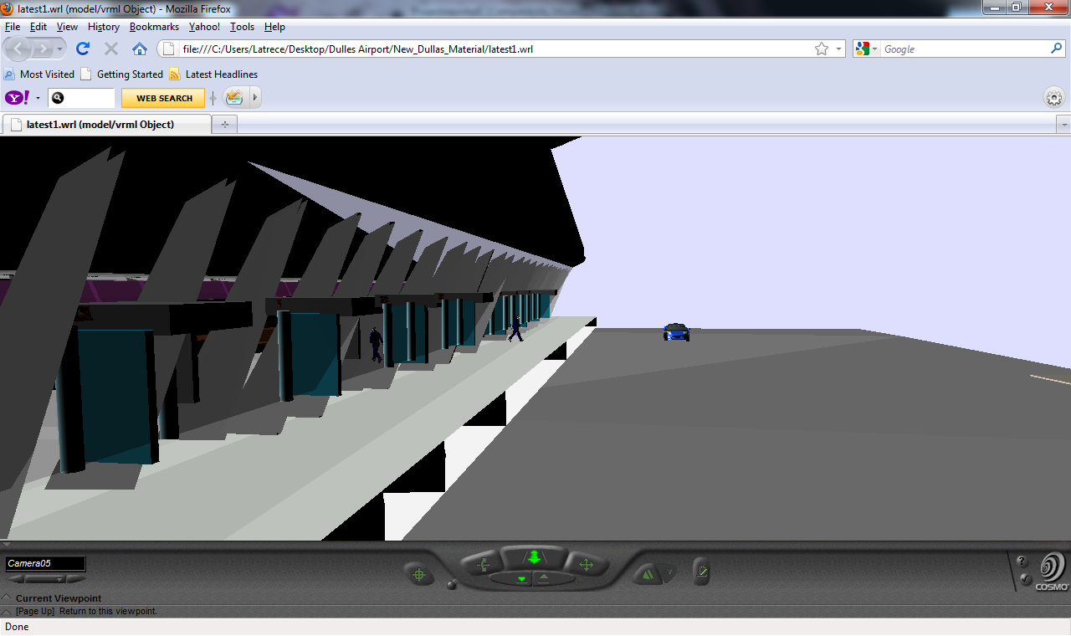
Dulles Airport
Alternate View

